Slide 1
Strategies, games and methodology to teach English through ICT and Journalism

Slide 2
Teach English by using technology
https://englishpost.org/tools-teach-english-technology/

Slide 3
The 5 Ws game
Introduction of the 5 question words Who/what/when/where/why and their explanation
Using Padlet( a shared virtual board), each student finds the 5 QW and and writes the answer to one of them. Just in case a QW doesn't receive any answer, they are obligated to do it.
At the end, the teacher shares the board showing what they have written and articles are put together.

Slide 4
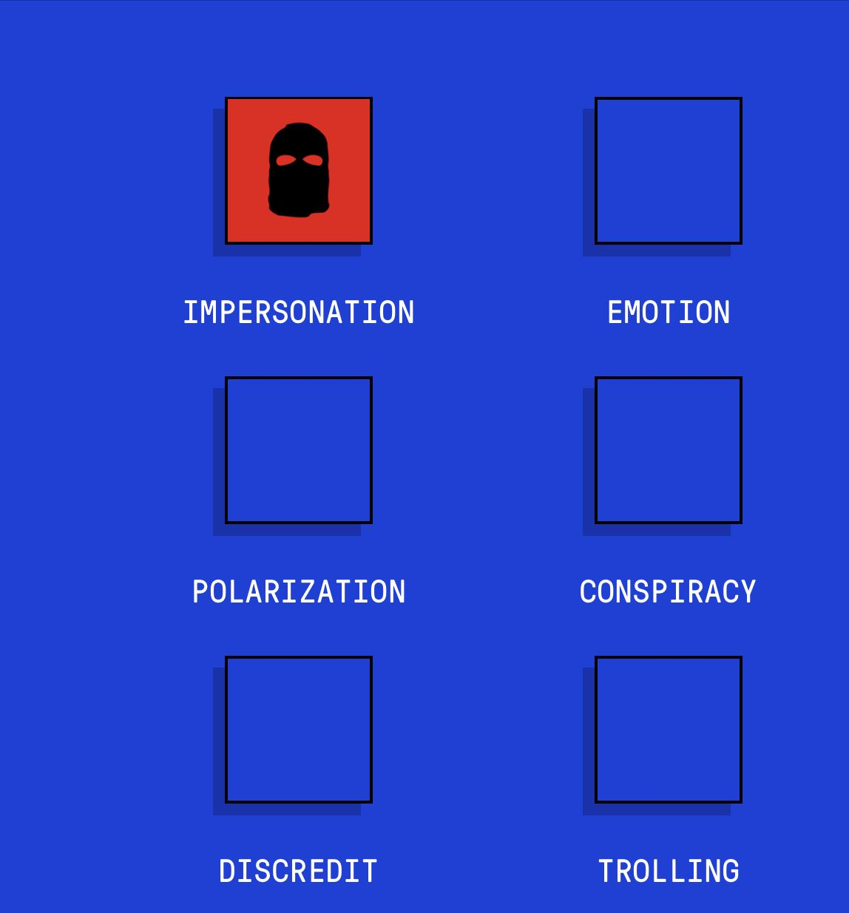
Bad News game
https://www.getbadnews.com/books/english/

Slide 5
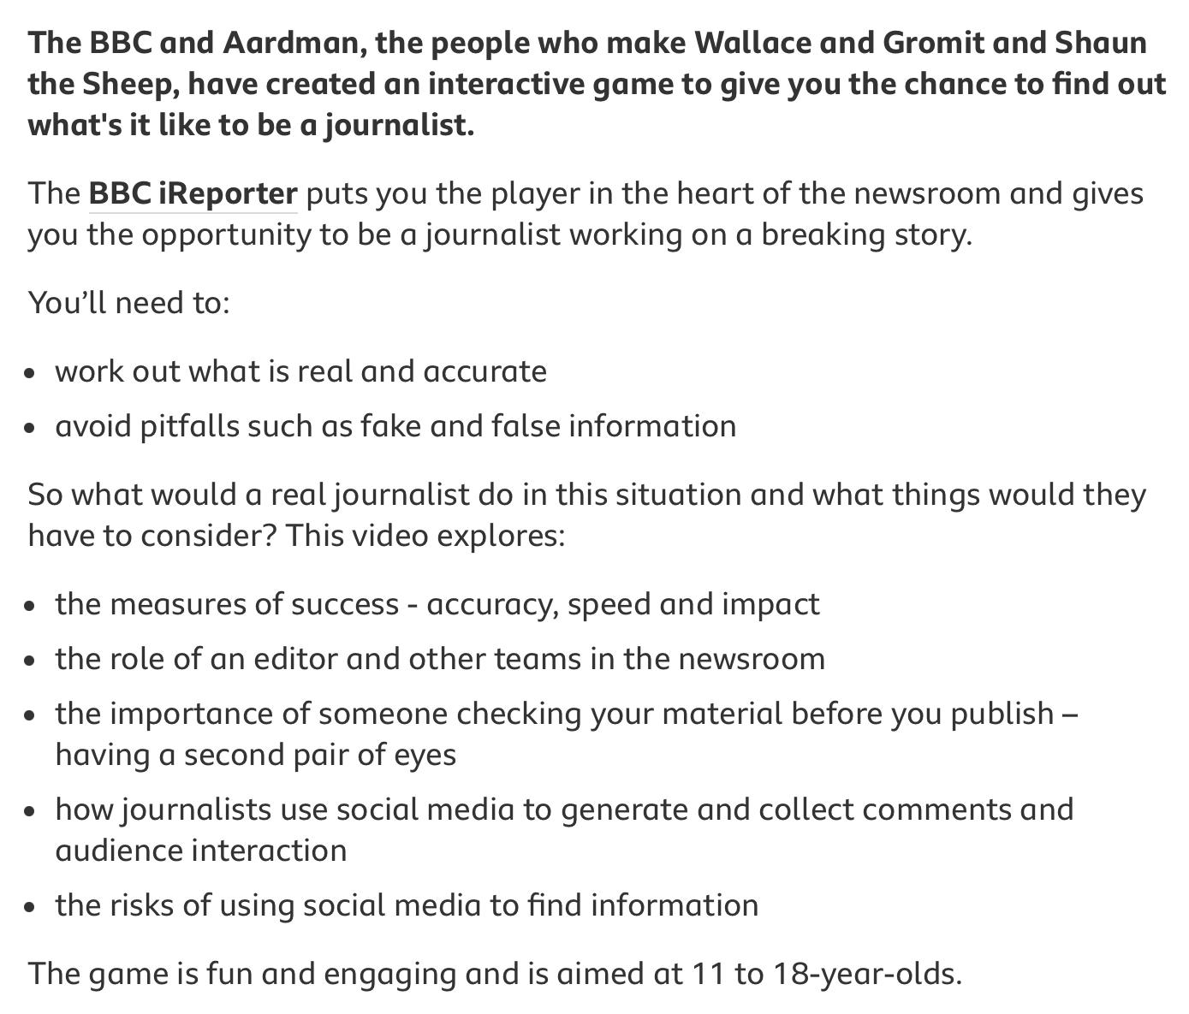
BBC IREPORTER
https://www.bbc.co.uk/news/resources/idt-8760dd58-84f9-4c98-ade2-590562670096
https://www.bbc.co.uk/teach/young-reporter/ireporter-guidance-for-teachers/zbb3hcw
https://www.bbc.co.uk/teach/young-reporter/ireporter-what-would-a-journalist-do-guidance-for-young-people/zr3vtrd

Slide 6
FACTITIOUS
https://medium.com/@bobhone.designer/how-to-play-the-factitious-2018-news-game-9969aaa8f2a7
https://participationpool.eu/resource/factitious-news-game-2018-pandemic-edition-2020/
http://factitious-pandemic.augamestudio.com/#/

Slide 7
Strategies, games and methodology to teach English through ICT and Journalism
Thank you

